Slide 1
Next Chapter AI’s Book Recommender System
By: Cherechi Uruakpa, Haley Karolevitz, JennyLou Spoon, and Noah Moore
Notes:
Hi everyone we are Next Chapter AI and today we are proud to present our Book Recommender System. But first I want introduce our team…etc.

Slide 2
01
02
Agenda
03
04
Data Overview
Data Preprocessing
System Design
Algorithms
05
Challenges
06
Final Result
Notes:
As for our agenda for today, I am going to start with an overview of the data we used and how we preprocessed it.
Then Haley and Cherechi are going to go into the design of the content-based and collaborative filtering algorithms that combined to make our recommender system.
And then Noah is going to conclude our presentation with some of the challenges we faced along the way before presenting our final hybrid model and its results.

Slide 3
01
Data Overview
Notes:
So first, the data…

Slide 4
Books.db
Contains three primary tables
Books
Ratings
Users
281,398 rows
ISBN
Title
Author
Year of Publication
Publisher
3 image URLs
1,179,118 rows
User-ID
ISBN
Book-Rating: 1-10 explicit, 0 implicit
553,940 rows
User-ID
Location
Age
Notes:
The database had 3 tables: Books, Ratings, and Users. Books had your typical info on books, ratings had the book ISBN numbers along with ratings 0-10 and a userid to track rated the book. And the User table had some simple information of those users.
CLICK
Through our data preprocessing in SQL that I will elaborate on in a minute, we removed the columns with the image URLs, and all of the implicit ratings. In the end system design that we did in Python, we didn’t actually end up incorporating any of the information from the Users table.

Slide 5
02
Data Preprocessing
Notes:
So how did we clean the data?

Slide 6
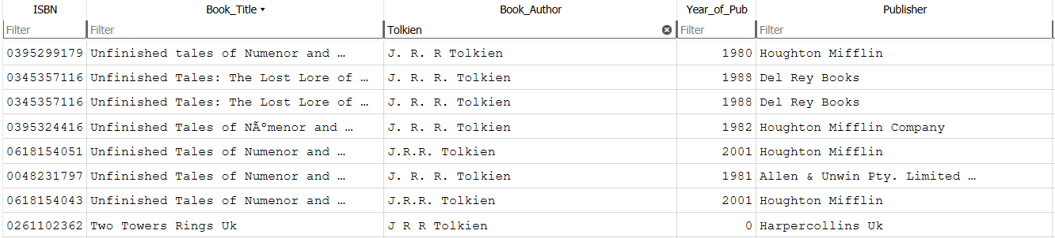
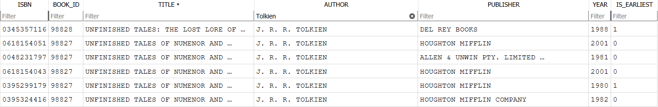
Preprocessing Steps - Books
Notes:
In addition to removing the image URLs, the Books table had the most cleaning involved. The raw Books table had a lot of inconsistencies like corrupted characters, missing author data, invalid ISBNs, Publication Years and duplicate entries.
CLICK
To get to our cleaned version,
We first cleaned and uppercased key text fields, removed extra spaces, and standardized author
We also replaced corrupted encodings like Ã© or Â by searching and identifying patterns to impute the correct letter.
Invalid years were nullified,
And we filtered out unreliable metadata, like rows where the author was listed as "N/A" or "Not available."
One of the biggest decisions we made was to keep only authors who had more than 10 distinct books in the dataset, to avoid overly sparse author signals in content-based filtering.
Every unique (title, author) pair was assigned a BOOK_ID,
And we flagged the earliest edition for each title to retain one canonical version per book.
SLIDE

Slide 7
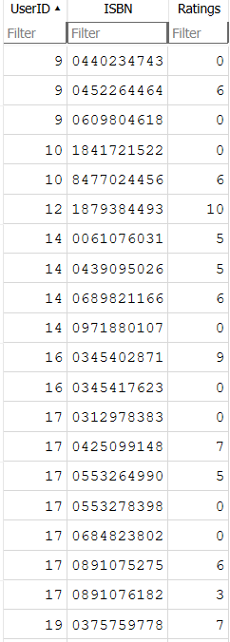
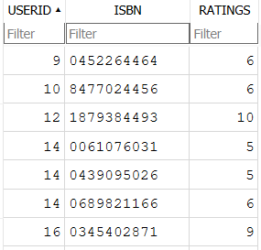
Preprocessing Steps - Ratings
Notes:
The ratings table was much easier to clean.
CLICK
we removed all entries where the rating was 0 — these are often considered implicit or uninformative.
Then we cleaned up ISBN formatting
and only kept ratings with valid ISBN lengths — either 10 or 13 digits — which ensures alignment with our cleaned Books table.
SLIDE

Slide 8
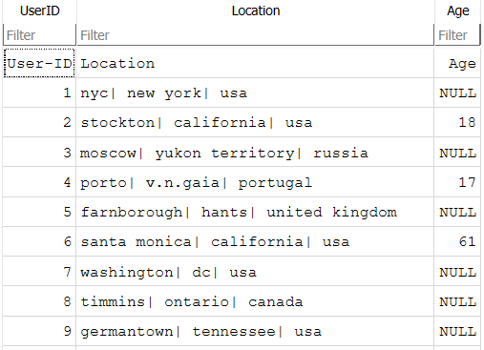
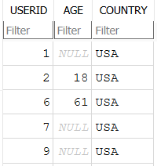
Preprocessing Steps - Users
Notes:
And though it didn’t end up getting used in the system design, we cleaned the Users table so it can be implemented in later iterations if desired
CLICK
The table had to be broken apart from a messy location field. We parsed out city, state or region, and country. From there, we standardized country names and converted all variants of “United States” to “USA.” Ages that were either missing, zero, or above 110 were also removed or nullified.
The final Users table includes only users based in the USA, which we had planned to use to localize our recommendations — although that filter wasn't actually enforced in the final system.
SLIDE

Slide 9
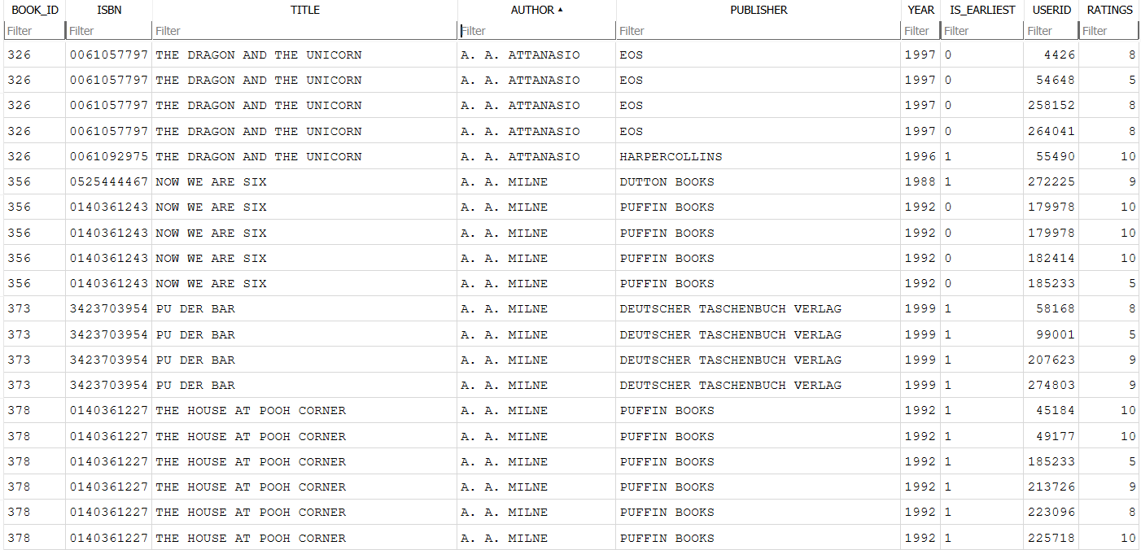
Final Table
Notes:
To get a table that had all the relevant information for our system, we created a table called REC_BOOKS, which includes all books that were either rated or marked as the earliest edition.
Then we joined that with the cleaned ratings to form a larger table of books and their user interactions.
After that, we selected the top 15,000 books based on number of ratings to reduce sparsity and keep the similarity matrices manageable. This gave us our final table, CONTENT_JOIN, which powers both the collaborative and content-based parts of our hybrid system.
So, by the time we reached modeling, all the data was standardized, de-duplicated, and focused on high-signal users and books.
SLIDE

Slide 10
03
Recommender
System Design

Slide 11
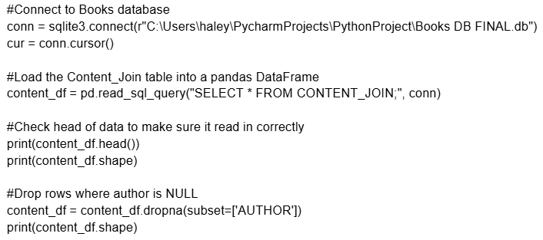
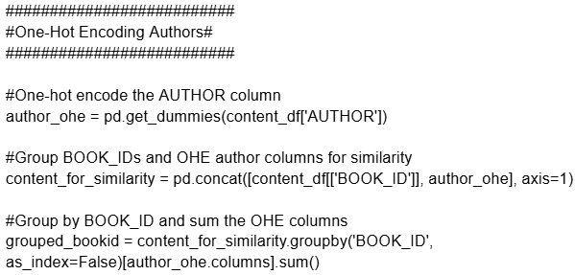
Content-Based Filtering
Approach:
Used Content_Join table
Key Fields: Book_ID, Title, Author, Is_Earliest, Year
Dropped entities with missing Author values
Applied one-hot encoding to the Author field
Similarity Metric:
Calculated cosine similarity between vectors
Removed diagonal entries to avoid self-recommendation
Filtering Logic
Set similarity threshold of 0.3 to ensure meaningful matches
Selected top N (5) recommendations for given book if available
Notes:
b. what did you use for content-based recommendations?

Slide 12
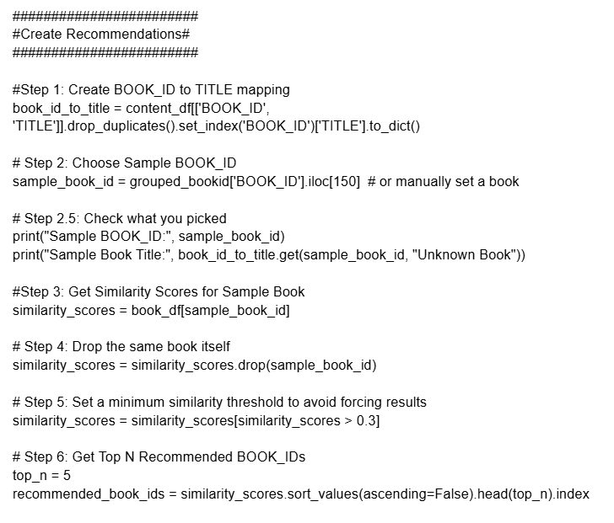
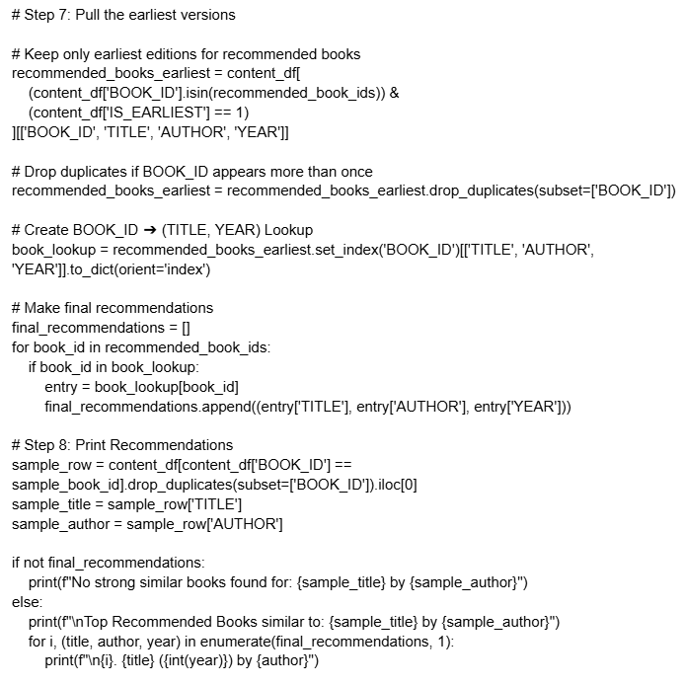

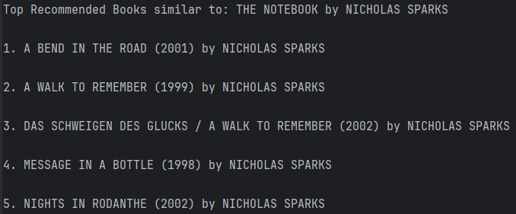
Content-Based Example

Slide 13
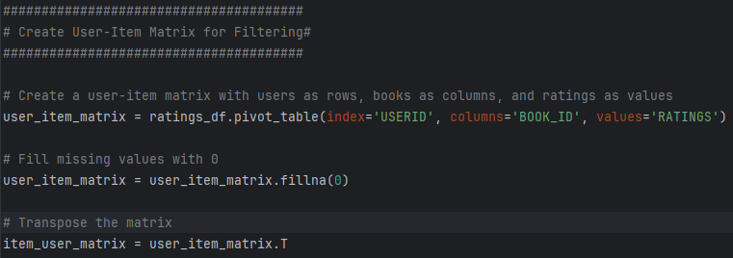
Collaborative Filtering
Approach:
Used CONTENT_JOIN table
Key Fields: USERID, BOOK_ID, RATINGS
Created user-item matrix with ratings as values
Similarity Metric:
Calculated cosine similarity between books based on user ratings
Removed diagonal entries to avoid self-recommendation
Filtering Logic
Found most similar books to user's top-rated items
Excluded books user already read
Selected top 5 most similar books
Notes:
What did you use for collaborative filtering,

Slide 14
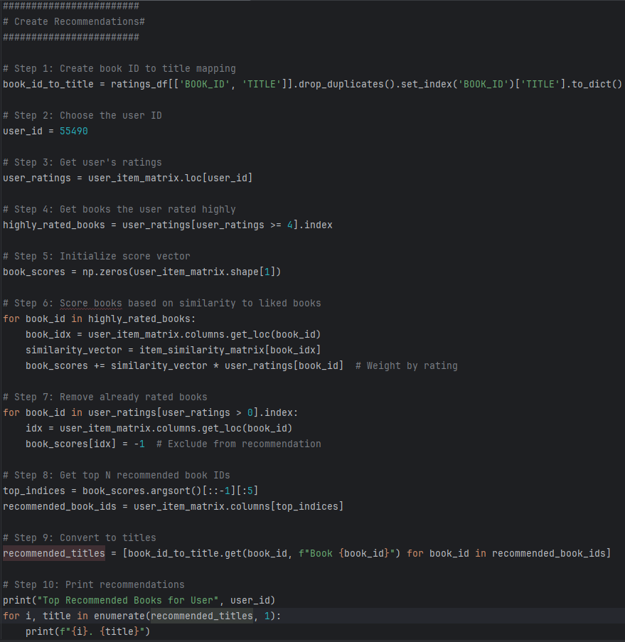
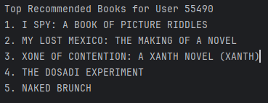
Collaborative Filtering Example

Slide 15
04
Analysis Algorithms
Notes:
e. What analysis algorithms did you use?

Slide 16
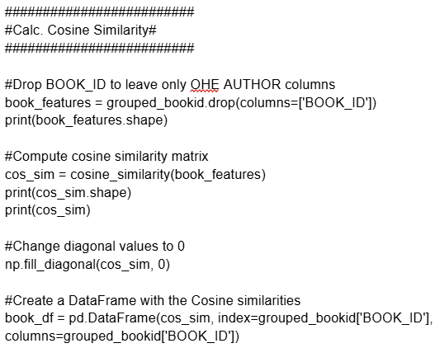
Content-Based Algorithms
What We Used
Cosine Similarity
Compares how alike two books are based on shared authorship
Works well for “yes/no” data like our one-hot encoded author values
How This Works?
Each book was turned into list of 1s and 0s based on author
Cosine similarity scores how closely two books match
Books do not recommend themselves
Why Cosine?
Better than Euclidean or Manhattan for our data
Focuses on who wrote the book, not how many authors or how “rare” they are

Slide 17
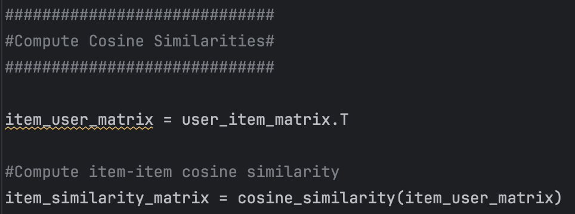
Collaborative Algorithms
What We Used: User-Item Cosine Similarity
Compares how alike two books are based on user ratings patterns.
Measures similarity between books by how users rated them, not by their content.
How It Works
Item-Item Similarity:
Cosine similarity compares books based on user ratings vectors.
Recommendation Logic:
Scores books by their similarity to the user’s highly rated books.
Excludes already rated books from recommendations.
Why This Approach?​
Recommends books that similar users enjoyed, rather than just similar authors.​
Captures patterns like: "Users who loved Book A also rated Book B highly."​
Cosine is better than Euclidean distance for sparse rating data.​
Focuses on rating patterns, not absolute values.​

Slide 18
05
Challenges

Slide 19

Failed Methods and Roadblocks
We did not attempt to incorporate any additional algorithms to our system
Had trouble with populating COLLABORATIVE_JOIN so CONTENT_JOIN was used for system
Started with too many results and had to narrow down scope for laptop computing (several times)
Didn't get to capitalize on USERS_FINAL changes
Limited book characteristics and user data shrunk the scope of our systems and simplified them to only focus on Author and Ratings
Forced to limit recommendations per author (more to come)
Notes:
g. What roadblocks did you face and how did you resolve them? h. Did you try any algorithms that did not work and were not incorporated in the final solution?

Slide 20
06
Final Result

Slide 21
Hybrid Recommender System
Approach
Data: CONTENT_JOIN table (ratings + metadata)
Key Fields: BOOK_ID, Title, Author, RATINGS
Preprocessing: Dropped books with missing authors
Algorithms (2)
Collaborative Filtering: User-item matrix → Cosine similarity
Content-Based: One-hot encoded authors → Cosine similarity
Hybrid: 50% collaborative + 50% content similarity, with 2 same author limit
Recommendation Logic​
Takes user’s top 5 rated books​
Scores unread books via hybrid similarity​
Excludes already read books​
Returns top 5 recommendations​
Output​
Personalized book suggestions with title, author, year​
Handles cold-start (no ratings → no recs)​
Able to give recommendations for every user
Notes:
Talk about the final results: i. How many algorithms are incorporated in the results? ii. What percent of people will get the full number of recommendations? iii. How many people got 0 recommendations at the end?

Slide 22
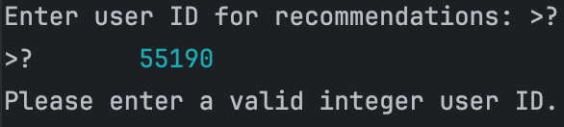
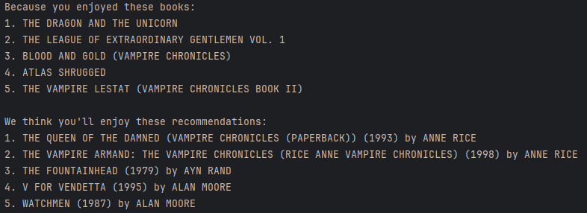
Hybrid Results
ERROR:
Notes:
Talk about the final results: i. How many algorithms are incorporated in the results? ii. What percent of people will get the full number of recommendations? iii. How many people got 0 recommendations at the end?

Slide 23
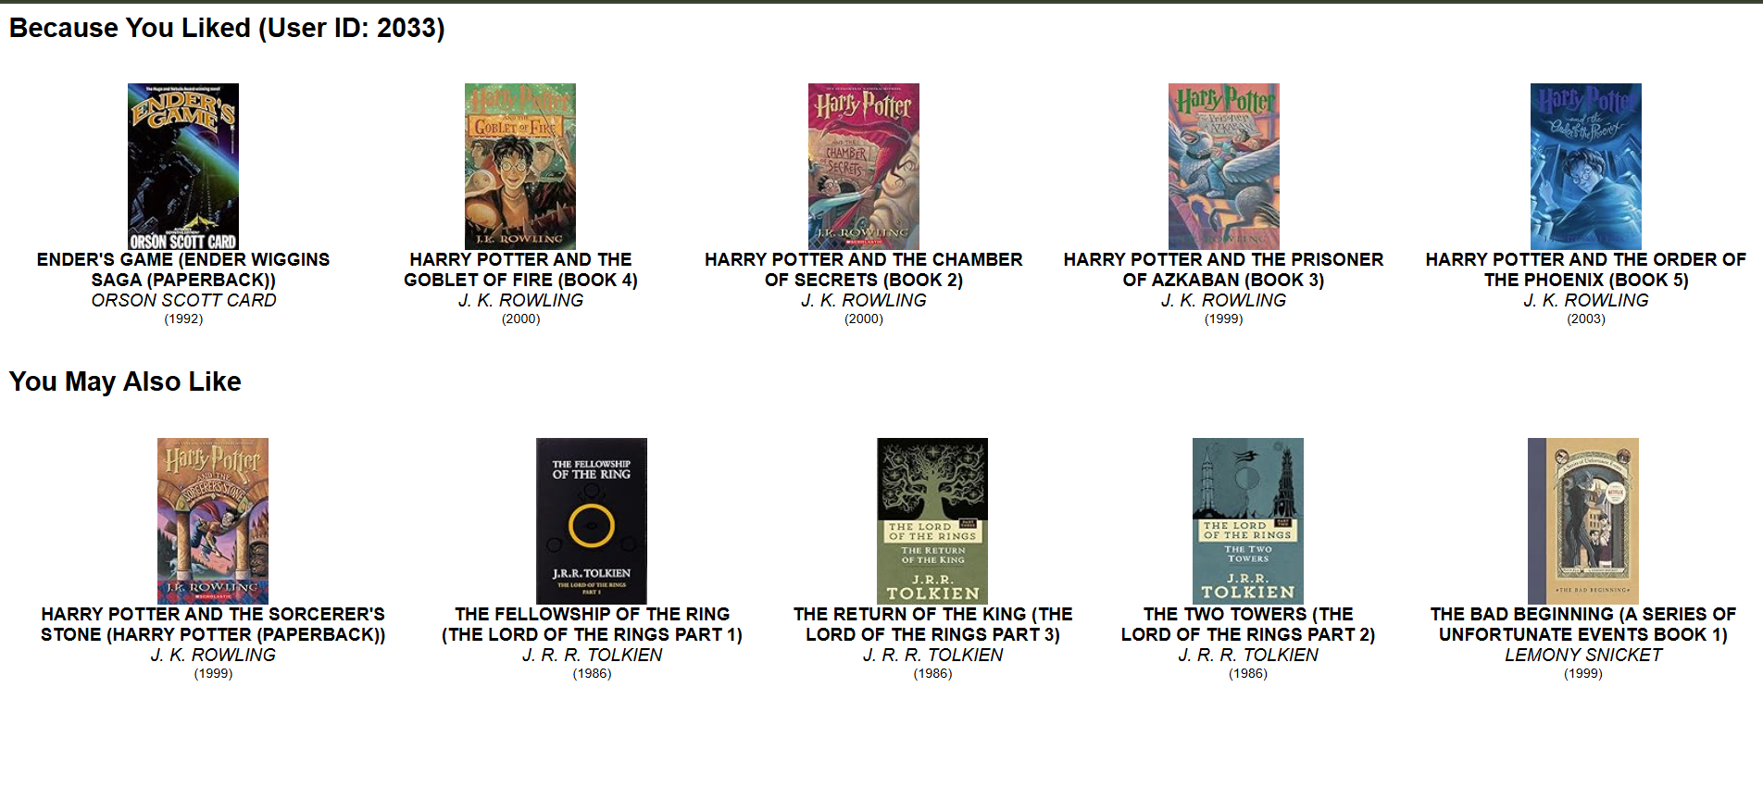
Implementation Example

Slide 24
Thank you!
Any Questions?

